Slide 1
Contact Info
Katherine Brainard
Office Hours:
Science Hall 247
Monday and Thursday 9:30am - 10:30am
Tuesday 1pm - 2pm, 2pm - 3pm by appointment
Email: brainark@newpaltz.edu

Slide 2
How to Get Help
Drop-in Office Hours
Appointment Office Hours
Email: 1 business day response time

Slide 3

Course Policies
Class will be interactive - please bring your laptop!
If you don't have regular access to a laptop:
Contact Kaitlin Hoffman (hoffmank4@newpaltz.edu) to coordinate a loaner laptop for the semester; there's a limited number of these, so reach out sooner rather than later
Outside of class, SH260 has computers you can use for working on assignments.

Slide 4
Coding Prerequisite Form
Needed to access Brightspace

Slide 5
Course Policies
Course material is only available via this course
If you:
Ask ChatGPT
Ask Google
Watch a youtube video
Ask stackoverflow
Answers will be missing important context
Supplement course materials = good
Instead of course materials = bad

Slide 6
Course Policies
tl;dr: No LLMs for checkpoints
Why:
Code for course != code LLMs are good at
Point of checkpoints is to practice material from course
Checkpoints must use material from course

Slide 7
Course Policies
Syllabus posted on Brightspace with more details/as a reference
Grade Breakdown:
20% Weekly Checkpoint Code Reviews
20% Final Project (partly built up through the weekly assignments)
30% Midterm Exam (open book, closed computer, during class time)
30% Final Exam (open book, closed computer, see final exam schedule)

Slide 8
Large Project: Buddy System
If you already have a project buddy, great!
If not: there will be time at the end of class today to find a buddy
Groups of up to 3 allowed, but they are more work
Each week:
Write code (individual)
Review code (swap with buddies)
Group brainstorming is allowed (and encouraged!)

Slide 9
Project Grading
Checkpoint Grade: Process, ie Code Reviews
Selecting code for review
Leaving substantive comments
Responding to comments
Multiple buddies = Multiple Independent Reviews
Final Project Grade: Functionality
Fixing everything from feedback
Adding on to course topics from outside resources

Slide 10

Project Grading
Checkpoints:
Recommended completion date (Brightspace will show this as ‘due date’)
Required test suite
Must respond to feedback from previous checkpoint (available 4 days after submitting)
Caution: Do not Fall Too Far Behind

Slide 11

Questions?

Slide 12
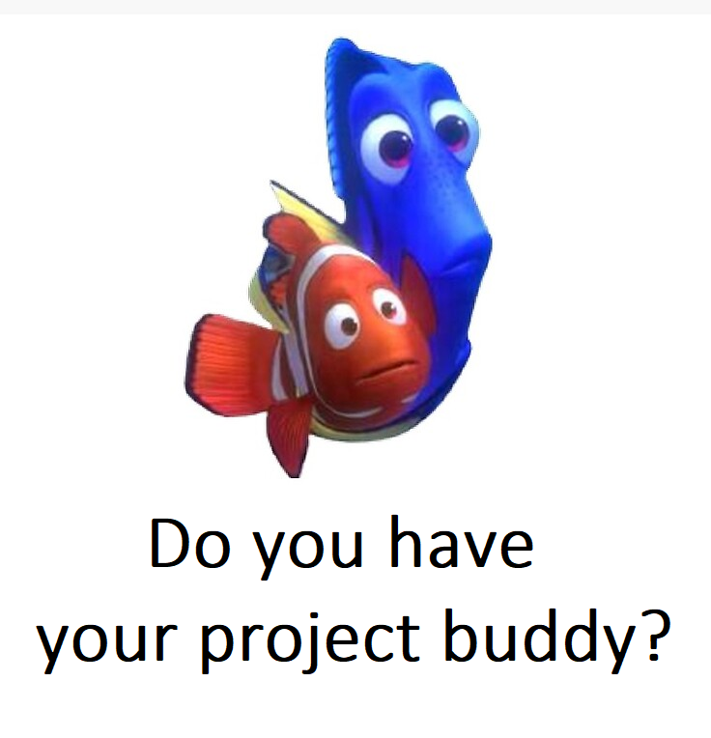
Checkpoint 0.5: Email me your Project Group
Must be completed by Thursday (next class)
Groups must be 2-3 people (recommended: 2)
Email me (brainark@newpaltz.edu)
your name
your buddy/ies
a team name
CC everyone on the email
You'll need a buddy for Checkpoint 1

Slide 13
Project Work Time
Find a buddy!
Start on Checkpoint 1 (on Brightspace)
Configuring new software is a fraught process, get through as much of this as you can in class in case of issues

